Slide 1

Analysis

Slide 2
HTTP Status Code
1xx Informational
2xx Success
3xx Redirection
4xx Client Error
5xx Server Error

Slide 3
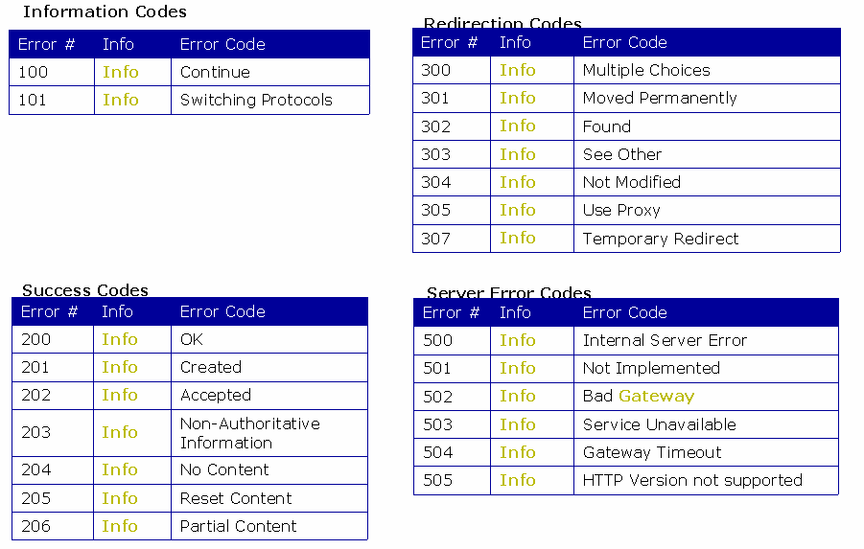
HTTP Status Code

Slide 4
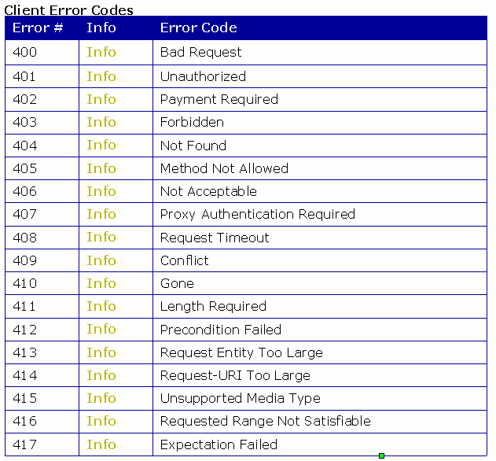
HTTP Status Code

Slide 5
What is a Counter?
A Counter is a unit that measures and gathers performance-relevant events of the system, which allows us to track the performance of your application
Application Counters
Response time
Throughput
Hits Per Second
Pass/Fail Statistics
Server Side Counters
Memory
Processor
Disk
Network

Slide 6
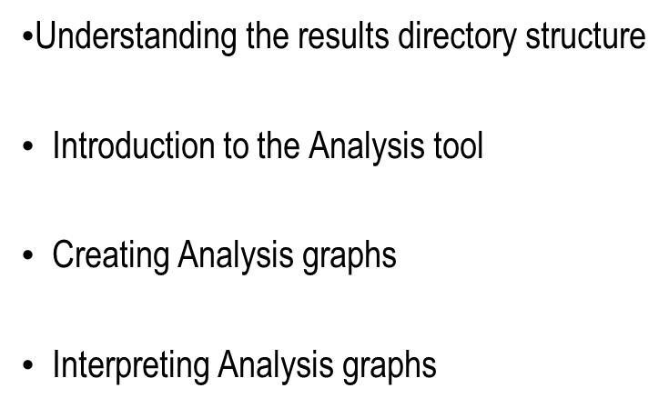
LR- Analysis

Slide 7
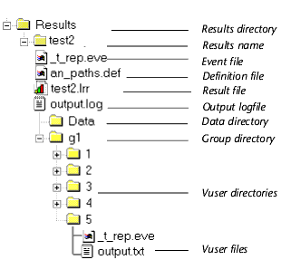
Results Directory Structure
In results directory, LoadRunner creates a subdirectory using the results name specified by us
All the data LoadRunner gathers is placed in that directory
Every set of results contains general information about the scenario in a result file (.lrr) and an event (.eve) file.

Slide 8
Results Directory Structure
During scenario execution, LoadRunner also gathers data from each Vuser and stores it in an event file _t_rep.eve and an output file output.txt
LoadRunner creates a directory for each group in the scenario and a subdirectory for each Vuser

Slide 9
The Analysis
The Analysis graphs helps to determine system performance and provides information about transactions and Vusers by combining results from several scenarios or merging several graphs into one.
The Analysis is the utility that processes the gathered result information and generates graphs and reports
The result file with an .lrr extension is the input to the Analysis tool
An Analysis session contains at least one set of scenario results (lrr file)‏

Slide 10
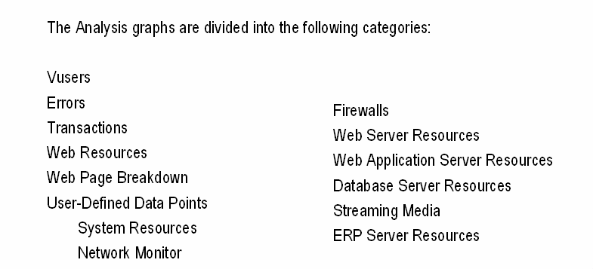
Analysis graphs

Slide 11
Analysis graphs
Vuser
Vuser graphs display information about Vuser states and other Vuser statistics
Error
Error graphs provide information about the errors that occurred during the scenario execution
Transaction
Transaction graphs and reports provide information about transaction performance and response time

Slide 12
Analysis graphs
Web Resource
These graphs provide information about the throughput, hits per second, HTTP responses per second, and downloaded pages per second for Web Vusers.
System Resource
These graphs show statistics relating to the system resources that were monitored during the scenario using the online monitor.
Network Monitor
Network Monitor graphs provide information about the network delays.

Slide 13
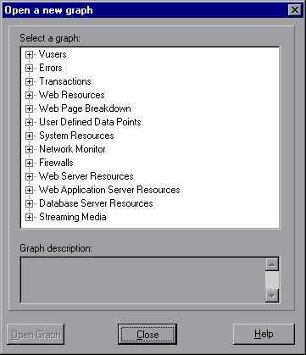
Opening Analysis graphs
By default, Load Runner displays only the Summary Report in the graph tree view
Select Graph > Add Graph or click <New Graph> in the graph tree view
This opens a New Graph dialog box
Choose the required graph

Slide 14
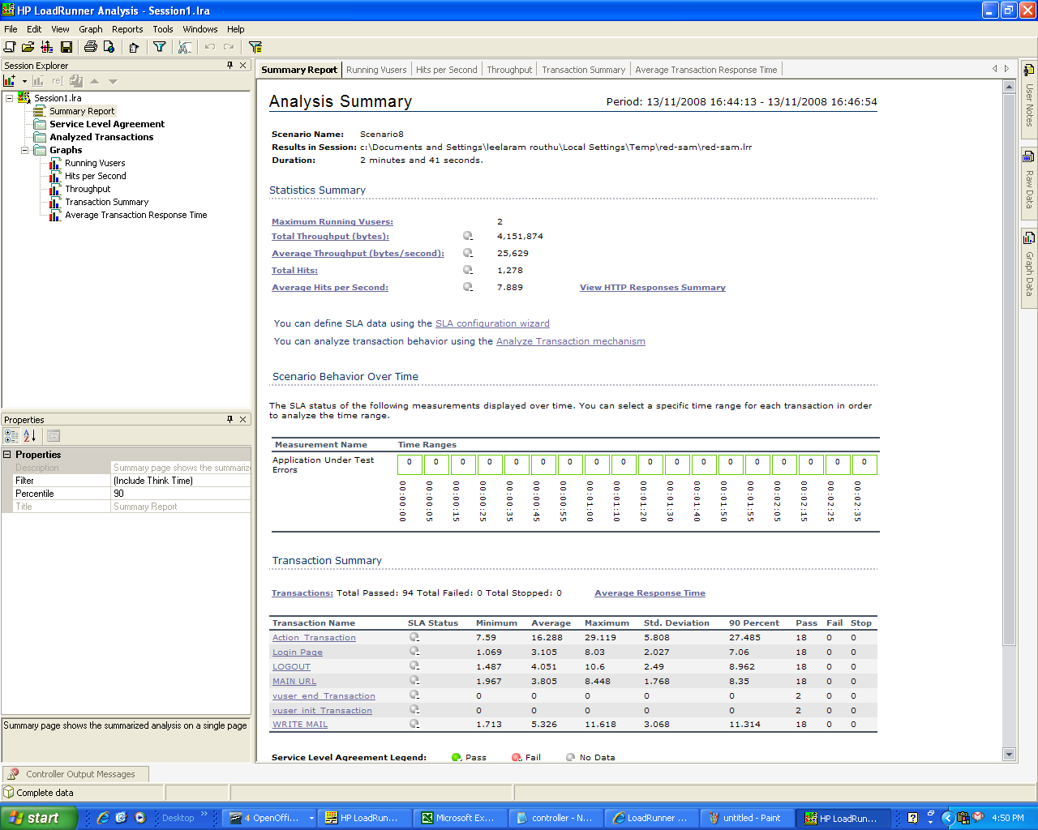
Analysis - Summary

Slide 15
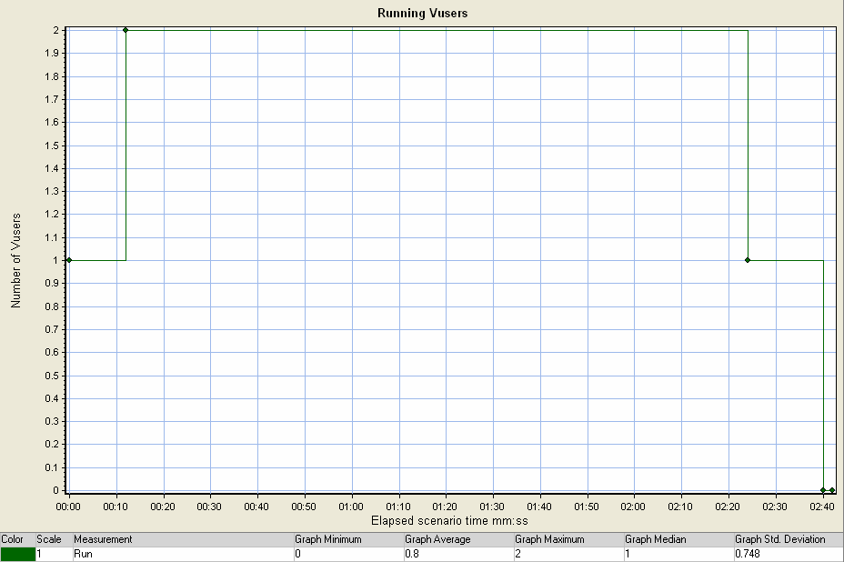
Running Vusers
Displays the number of Vusers that executed Vuser scripts, and their status, during each second of a load test. This graph is useful for determining the Vuser load on your server at any given moment.

Slide 16
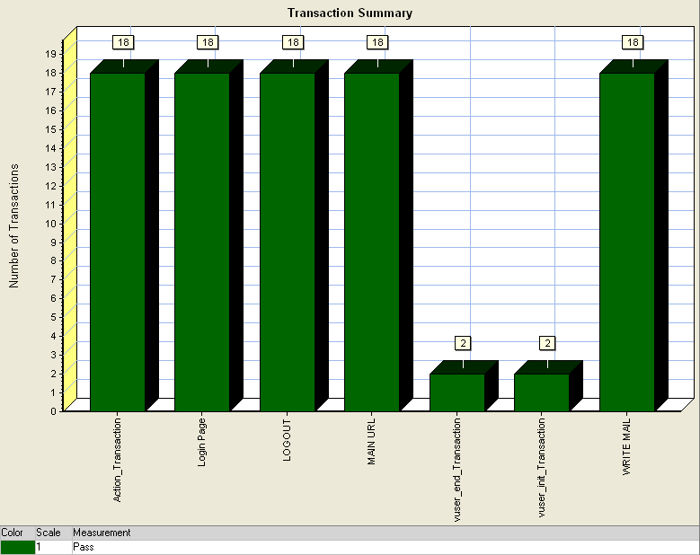
Transaction Summary
Displays the number of transactions that passed, failed, stopped, or ended with errors.

Slide 17
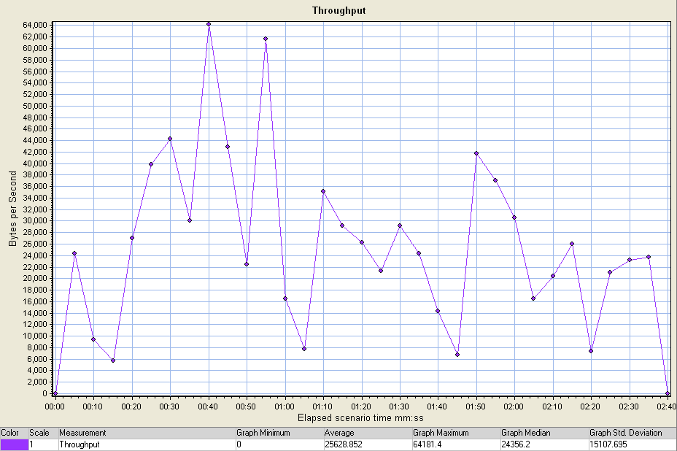
Throughput
Displays the amount of throughput (in bytes) on the Web server during the load test. Throughput represents the amount of data that the Vusers received from the server at any given second. This graph helps you to evaluate the amount of load Vusers generate, in terms of server throughput.

Slide 18
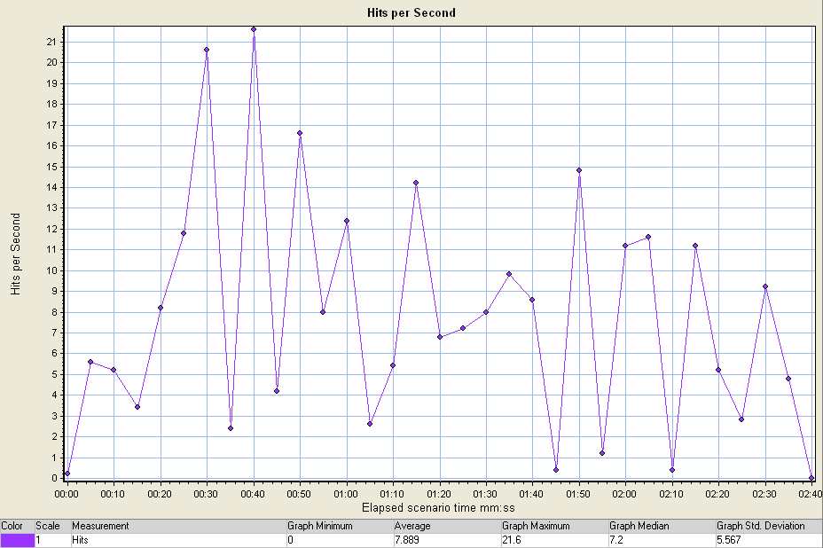
Hits Per Second
Displays the number of hits made on the Web server by Vusers during each second of the load test. This graph helps you evaluate the amount of load Vusers generate, in terms of the number of hits.

Slide 19
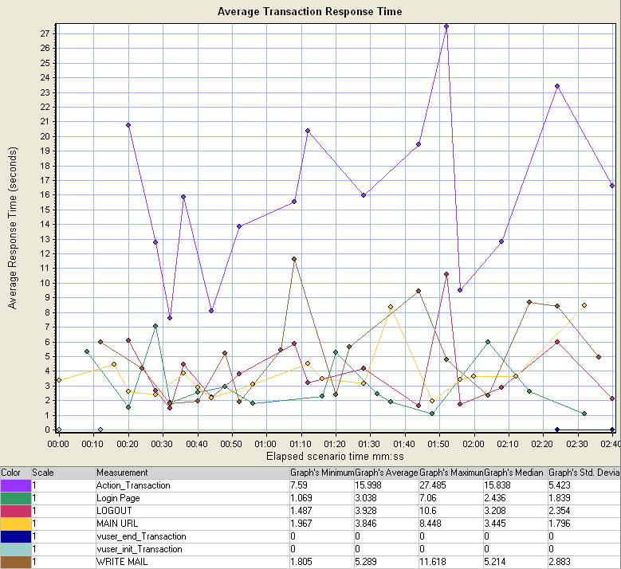
Avg Transaction Response Time
Displays the average time taken to perform transactions during each second of the load test. This graph helps you determine whether the performance of the server is within acceptable minimum and maximum transaction performance time ranges defined for your system.

Slide 20
Thank you

